Slide 1

Introduction to Forensic Sciences

Slide 2
Unit I
Definition and need of Forensic Sciences
Role and Functions of Forensic Sciences
Disciplines of Forensic Sciences
Historical aspects of Forensic Sciences
History and development of forensic sciences in India
Basic principles of forensic science

Slide 3
DEFINITION
Application of knowledge and technology of science to law enforcement.
Forensic science generally served to confirm identifications and the nature of well-defined evidence items.
In definition of forensic science, it is the application of scientific methods or techniques to law or legal system to helps in answering the questions of interest to a legal system in relation to either civil or criminal action.
“Forensic science is the application of science to the criminal and civil laws that are enforced by police agencies in a criminal justice system” – Richard Saferstein
Forensic science is the application of natural sciences to the matters of law. Forensic science is linked to physics chemistry, biology and other scientific methods and techniques. It involves recognition, identification, individualization and evaluation of physical evidence for the purpose, of administration of criminal justice.

Slide 4
NEED AND SCOPE OF FORENSIC SCIENCE
Modernisation and technical advances. A great need to use of forensic science in the investigation of crime in the modern times.
Technical know How. Refined ways of committing crime.
Obscurity. Social animal to self-centred human
Ancient methods. The investigation of crime and prosecution of persons having committed the crime are not up to the mark and with many loopholes leading to acquittal.
Extensive Area. The field of operation are now national as well as international.
Increasing awareness and establishment of National Human Right Commission.
Thus, there is an urgent need to use scientific techniques for effective crime investigation.

Slide 5
ROLE AND FUNCTIONS OF FORENSIC SCIENCE
It answers the “who (perpetrator), what (corpus delicti), where, when, and how (modus operandi)” questions pertaining to the crime that was committed.
Forensic Science may prove
the existence of a crime,
the perpetrator of a crime,
a connection to the crime
through the examination of physical evidence,
administration of tests,
interpretation of data,
clear and concise reporting,
and truthful testimony of a forensic scientist.
It can be used by the prosecution to prove the guilt of the accused beyond a reasonable doubt on one hand and can also be relied upon by the defence to prove innocence on the other.

Slide 6
DISCIPLINES OR FIELDS OF FORENSIC SCIENCE
Various fields of forensic science that help in criminal investigation including
Forensic Entomology
Forensic Toxicology
Forensic Psychiatry
Forensic Ballistics
Document Examination
Forensic Anthropology
Forensic Odontology
Forensic Chemistry
Forensic Biology (DNA Profiling)
Fingerprinting

Slide 7
Forensic Entomology
Forensic Entomology is the application of the study of insects and other arthropods to legal issues.
Most contributing insects: Flies (Blow flies, flesh flies, house flies) and beetles (Rove beetles, carrion beetles)
Insects have been used to
1) locate bodies or body parts,
2) estimate the time of death or post-mortem interval (PMI),
3) determine the cause of death,
4) determine whether the body has been moved after death,
5) identify a criminal suspect, and
6) identify the geographic origin

Slide 8
Forensic Toxicology
Forensic toxicology is a discipline that involves the identification and quantification of drugs and other poisons or toxins in body tissues, including blood.
Forensic toxicology disciplines covers
death investigation, and
aspects related to behavioural or human performance such as impaired driving due to drug consumption, steroid use by athletes, and workplace drug testing.
Include biological samples, drugs, toxins, plants, environmental chemicals, and any product where the results of the analysis may clarify criminal activities and past or current events.

Slide 9
Forensic Psychology
Forensic psychiatry represents a discipline dealing with the evaluation of the mental state of criminals.
Evaluating an individual's capability to face trial, defense grounded on psychological diseases or deficiencies (e.g., insanity) and sentencing recommendations
Various techniques to detect deception are
POLYGRAPH also called as the mechanical lie detector is a process by which a study of functioning of different body systems is studied to detect lies.
Polygraph measures or records the following four parameters: a. Blood Pressure, b. Respiration, c. Galvanic Skin Reaction, and d. Pulse. The person has to answer the questions in “Yes” or “No” as answers.
NARCO-ANALYSIS is a procedure of investigation of mental content of a person done after application of light general anaesthetic drugs.
The drugs that are generally employed during the procedure of Narco-analysis are Scopolamine hydro bromide, Sodium secnol, Benzodiazepines and Thiopentone sodium or Sodium pentothal.
BRAIN FINGERPRINTING uses electroencephalography (EEG) to measure event-related potentials, known as the P300 (electrical events beginning 300 milliseconds after exposure to a stimulus)
P300 wave as "MERMER"- Memory And Encoding Related Multifaceted Electroencephalographic Response.

Slide 10
Forensic Anthropology
It includes the collection, preservation and analysis of human skeletal remains for identification and reconstruction of the events surrounding the death of an individual.
It can help in:
Determination of species – The bones should be sorted out into human and nonhuman bones.
Determination of age – The appearance and union of centres of bones. The growth and certain other changes in bones and teeth helps the investigator in determining the age of the individual at the time of death.
Determination of sex – The adult skeleton has several morphological differences between the different sexes.
Determination of Race –morphological characteristics which are confined to individual of a particular race.
Height –can be calculated with reasonable accuracy by applying formulae to the length of individual bones, especially the long bones of limbs.

Slide 11
Forensic Odontology/ Dentistry
Forensic odontology is a subspecialty within dentistry using dental examination for legal or criminal cases.
It plays a pivotal role in
Identification of human remains (burned or decomposed body)
Age estimation
Identification following mass fatalities
Assessing bite mark injuries
Assessment abuse cases (child, spousal, elder)

Slide 12
Forensic Chemistry
Forensic chemistry is the application of principles of chemistry to law enforcement and criminal justice system.
Forensic chemists analyses the materials to determine their nature and establishing a link between crime, criminal and victim.
Perform different analyses to identify materials in order to determine the nature and composition of such evidence.
Organic and inorganic analysis.
Each method of analysis uses specialized techniques and instrumentation (Spectroscopy, chromatography etc.).
Examination of metal alloys and metal fragments, petroleum products, dyes, paints, inks, construction material (like cement, bricks, etc.), various narcotic, designer and abused drugs, illicit liquors, pesticides, explosives, firearms and ammunition.

Slide 13
Forensic Biology
The examination of biological materials play an important role in connecting the criminal with the crime.
Includes analysis of biological evidences.
It mainly involves recognition and identification of blood and various other body fluids at crime scene
Perform DNA profiling on dried bloodstains and other body fluids,
Compare hairs and fibres, and identify and compare botanical materials such as wood and plants

Slide 14
Forensic Ballistics
Ballistics -scientific analysis of firearms, bullets, and the trajectories of projectiles in flight
Examines firearms, discharged bullets, cartridge cases, shot-gun shells, GSR and ammunition of all types.
Ballistic experts establish facts during shooting related crimes including…
Type of firearm (shotgun, rifled, handguns or country-made)
Calibre of bullet (the diameter of the inside of a firearm’s barrel)
No of bullets fired
Position of shooter during the crime
whether the weapon has been used in previous criminal cases

Slide 15
Questioned Document
‘Document’ is a vast topic covering writing with any material such as pencil, pen or ink or with any object on any material example a paper inscription/engraving on a metal plate, stone slab or any other material, typewritten, cyclostyled, printed, lithographed, photographed matter, chart map, plan etc.
A questioned document -authenticity is challenged.
Also known as ‘disputed’ or ‘contested’ documents.
Signature or thumb impression
The subject matter
Any alteration in the document
Photocopies and carbon copies
Anonymous letters
Age of document (artificial aging)

Slide 16
Examination
Magnifiers, microscopes, light sources, ESDA (Electrostatic Detection Apparatus), VSC (Video Spectral Comparator)
ESDA: An electrostatic detection device that is a specialized apparatus regularly used for questioned document analysis to decipher indentations or impressions in paper
Detection of Cheques Forgery, Traced Forgery, and Ransom note, an anonymous letters
VSC: An integrated composite system comprising of cameras, various light sources which includes IR, Laser, UV etc. and filters which assist in comparison of questioned documents.
For the visual examination of Questioned Documents and Security Documents

Slide 17
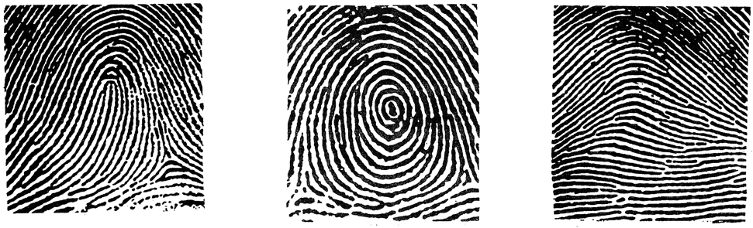
Fingerprinting
Fingerprints are the distinctive ridges appearing as corrugated lines on the tips of fingers and thumbs.
The science of identification by screening and comparing fingerprints is called Dactyloscopy.
The ridges are said to be first discernible in the third month of fetal life, and fully formed by the sixth.
Fundamental Principles of Fingerprinting:
No two persons and no two fingers of the same person have identical ridge design on the fingertips.
The fingerprints remain unchanged throughout life.
Fingerprints can be classified for record keeping.
There are three broad patterns of fingerprints: Loop (60%), Whorls (35%) and Arch (5%) .

Slide 18
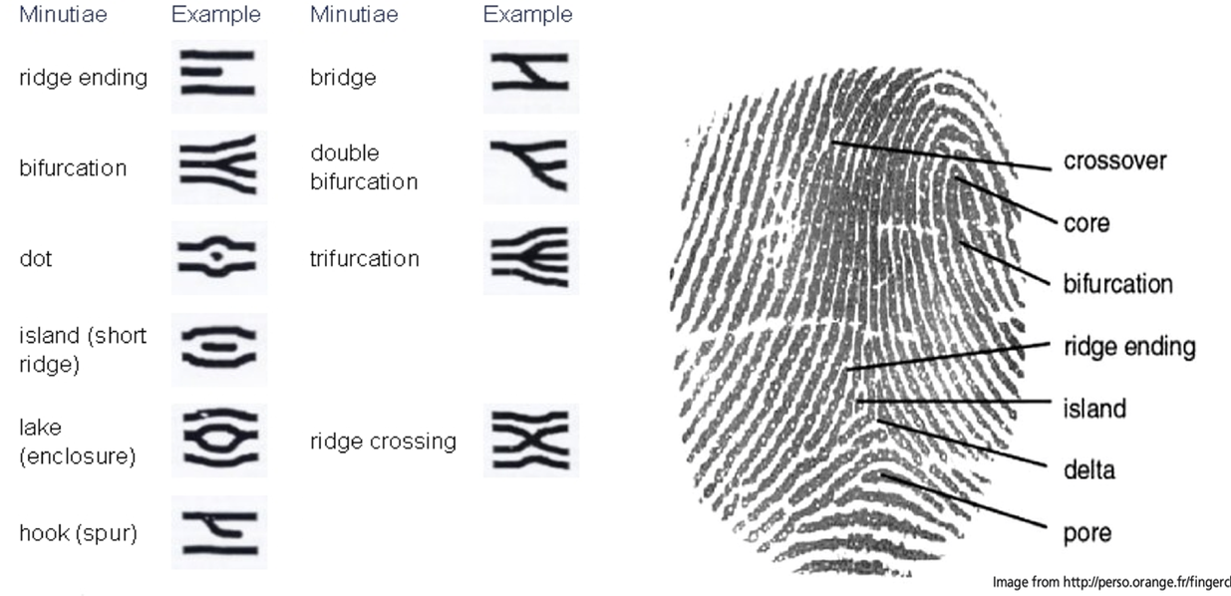
The general pattern type (loop, whorl or arch) - to make initial comparisons and include or exclude a known fingerprint.
Fingerprints have been used for forensic identification purposes, due to features within their patterns called ridge characteristics or minutiae.
There are different types of ridge characteristics, which are as follows:
Ridge ending,
Bifurcation,
Trifurcation,
Interjunction/Bridge
Fragment/short ridge,
Enclosure/lake,
Island/Dot,
Intersection/ ridge crossing
Return,
Hook/spur.

Slide 19
Types of fingerprints and detection
Patent Fingerprints:
Visible prints,
Can be made by blood, grease, ink, or dirt. easily visible
Plastic Fingerprints:
Three-dimensional impressions,
Indentation on soft surfaces.
Made by pressing your fingers in fresh paint, wax, soap, or tar
Latent Fingerprints:
Invisible to the naked eye,
Made of the sweat and oil on the skin’s surface,
For non-porous smooth surfaces, experts use powder-and-brush techniques, followed by lifting tape
For rough surfaces, the same powdering process is used, but instead of using regular lifting tape for these prints a gel-lifter or Mikrosil (a silicone casting material) is used
For porous surfaces, scientists sprinkle chemicals such as ninhydrin over the prints and then take photographs of the developing fingerprints.

Slide 20
HISTORICAL ASPECTS OF FORENSIC SCIENCE
Mathieu Orfila : “Father of forensic toxicology”, detection of poisons and their effects on animals
Calvin Goddard : “Father of Ballistics” developed the techniques for examination of fired bullet using the comparison microscope
Ludwig Teichmann: developed the first microscopic crystal test for haemoglobin
Alphonse Bertillon: “Father of Anthropometry or criminal identification”, first scientific system of personal identification, developed the science of anthropometry a systematic procedure of taking a series of body measurements
Hans Gross : the application of scientific to the field of criminal investigation. Coined term “criminalistics”

Slide 21
Francis Galton : “Father of Fingerprinting” first definitive study of fingerprints, describe the basic principles of identification by fingerprints
Leone Lattes : “Father of Bloodstain Identification” developed method for determining the blood group of a dried bloodstain
Albert S. Osborn : “Father of Document Examination” the fundamental principles of document examination
Walter C. McCrone : “Father of Microscopic Forensics”, developed and applied microscopy to analytical problems, particularly forensic science cases for evidence examination
Edmond Locard : “Father of criminalistics”. Locard’s exchange principle, when a person comes in contact with an object or person, a cross-transfer of materials occurs. Built the world’s first forensics lab in France in 1910.
Sir Alec Jeffreys : First to develop a DNA profile (DNA fingerprint)

Slide 22
HISTORY AND DEVELOPMENT OF FORENSIC SCIENCE IN INDIA
Government Chemical Examiner Laboratory 1849
The first Chemical Examiner's Laboratory was established for this determination at the then Madras Presidency, under the Department of Health
Calcutta (1853), Agra (1864), Bombay (1870) and Lahore (now in Pakistan).
Assisted by the medico-legal work and equipped to handle toxicological analysis of viscera, chemical analysis of food, drugs, biological analysis of blood and semen stains, etc.
Anthropometric Bureau 1879
Alphonose Bertillon introduced “Anthropometry” for criminal identification by taking body measurements.
“Bureau of Anthropometric Measurements” was introduced to maintain the anthropometric records of criminals, was well-known in 1892 at Calcutta.

Slide 23
Fingerprint Bureau
William Herschel, the Gatherer of the District of Hooghly (Bengal) establishes that patterns on the fingertips of a individual not ever altered throughout his lifetime.
Devised a system of registration of finger or thumb impressions of native contractors.
In 1891, Edward Richard Henry, Inspector General of Bengal Police made the thumb impressions compulsory in the record slips along with anthropometric data, to avoid mistake in the identification.
1897, it was mandatory to maintenance of duplicate criminal records with impressions of 10 fingers separately.
Khan Bahadur Azizul Huq and Rai Bahadur Hem Chandra Bose under Henrys general supervision developed the classification of finger prints.
The World’s first fingerprint bureau was set up at Calcutta (now Kolkata) in 1897.
Bose invented the first telegraphic code system for fingerprints and published it in 1916. Bose also devised the first single digit fingerprint classification system in 1927

Slide 24
Department of Explosive
1898, The Department of Explosives was established at Nagpur.
Later on 5 local workplaces at Calcutta, Bombay, Agra, Madras and Gwalior.
In 1902, establishment of C.I.D, facility for fire-arm examination, police photography, handwriting and fingerprints examination.
Government Examiner of Questioned Document
1904, the British Government of Bengal created the post of Government Handwriting Expert of Bengal and appointed Mr. CR Hardless.
1906, shifted to Shimla and was placed under the control of the Director, CID.
Similar type of Laboratories (GEQD) were set up at Calcutta and Hyderabad.
Presently GEQD Kolkata, Shimla and Hyderabad has been merged with CFSL, Kolkata, Chandigarh and Hyderabad respectively

Slide 25
Serologist to the Government of India
Serology Department was recognized in Calcutta in 1910, providing valuable scientific backing by investigating biological constituents for crime examinations.
After independence, changed to ‘Office of the Serologist and Chemical Examiner to the Government of India’
Footprint Section, Criminal Investigation Department
1915, a Footprint Unit was recognized below the CID, Government of Bengal.
Helped the police authorities to identify criminals through the examination of footprints collected from the scene of crime.
Note Forgery Section, Criminal Investigation Department
1917, A Section for detecting forgery in currency notes was recognized under the CID to undertake the examination of forged currency notes.
Government Mint and Security Printing Units at Nasik also established their own research laboratory for identifying cases of counterfeit and forged currency notes.

Slide 26
Ballistics Laboratory
1930, A minor Ballistic Laboratory was established along with an arms expert under the Calcutta Police to deal with the examination of firearms.
Scientific Sections, Criminal Investigation Department
During 1936 investigating agencies realized the importance of scientific disciplines in the detection and investigation of crime.
Scientific Section was established under the CID in Bengal and amenities were produced for investigation of bullets, cartridge cases, firearms, etc., used in committing crime.
State Forensic Science laboratory, Calcutta
1952, The first state forensic science research laboratory in India was recognized at Calcutta by merging Government Chemical Examiners Laboratory. functional in 1953.
The Medico-legal Division of the Chemical Examiner's Laboratory, the Footprint and the Note Forgery and General Chemistry Division of the Chemical Examiner's Laboratory was also shifted to this laboratory.
1955, a small unit of Physics was established.

Slide 27
Central Finger Print Bureau
The first Central Finger Print Bureau (CFPB) in India was established in 1905 at Shimla and abolished in 1922.
Restarted functioning from 1955 in Delhi under the administrative control of Intelligence Bureau (IB).
During August 1956, the CFPB was shifted to Calcutta
September 1973, it was transferred to the Central Bureau of Investigation
During July 1986, the administrative control of the CFPB was transferred to the National Crime Records Bureau (NCRB) and was again shifted to New Delhi.
Central Detective Training School, Calcutta
1956, CDTS Calcutta, a premier detective training school in India was established co-located with the CFPB, Calcutta.
To impart training in scientific investigation of crimes like drug abuse, terrorism, explosion, crime against women, investigation of road accidents and enforcement of traffic laws, etc.
Police officers from the neighbouring countries like Nepal, Sri Lanka etc. were also get training.

Slide 28
Central Forensic Science Laboratory , Calcutta
1957, the first Central Forensic Science Laboratory was established at Calcutta.
Organized into four basic disciplines viz. Forensic Physics, Forensic Chemistry, Forensic Biology and Forensic Ballistics.
The Neutron Activation Analysis Unit of CFSL, Calcutta was set up in 1970 at the BARC (Bhabha Atomic Research Centre), Trombay
CFSL, Centre of excellence Biological Sciences, is working under the Directorate of Forensic Science Services located at CGO complex, Lodhi Road, New Delhi.
Central Forensic science Laboratory ,Hyderabad
1965, The 2nd Central Forensic Science Laboratory was recognized at Hyderabad.
organized into basic disciplines viz. Forensic Physics, Forensic Chemistry, Forensic Biology and Forensic Ballistics.
CFSL center of excellence Chemical Sciences, is working under the Directorate of Forensic Science Services located at CGO complex, Lodhi Road, New Delhi.

Slide 29
Central Forensic Institute, Calcutta
CDTS and CFSL, (later on GEQD also) in the same premises, under the control of Intelligence Bureau, the whole set up was named as the Central Forensic Institute (CFI), Calcutta
CDTS, Hyderabad and Chandigarh
1964, The Central Detective Training School, Hyderabad
1973, The Central Detective Training School Chandigarh

Slide 30
BASIC PRINCIPLES OF FORENSIC SCIENCES
The principles of forensic science are essential in crime scene investigation to link a suspect with the crime scene as well as victim to the crime scene and suspect to assist in building a strong case against an accused and conviction.
There are 7 basic principles of forensic science which include
Law of Individuality
Law of Progressive change
Principle of Comparison
Principle of Analysis
Law of Exchange or Locard’s principle of Exchange
Law of Probability
Law of Circumstantial facts

Slide 31
1. Law of Individuality
Given by Paul L Kirk (1963) and is regarded as the building block for forensic science.
Every object, natural or man-made, has an individuality which is not duplicated in any other object
OR
No two things in this universe are alike even when they are manufactured in the same machine one after the other
The law of individuality has fundamental importance and form the basis for forensic identification.
Anything and everything involved in a crime has individuality. If the same is established, it link the crime and the criminal.

Slide 32
2. Law of Progressive change
‘Everything changes with the passage of time’
In simple words, nothing is permanent and the rate of change varies on different objects.
The rate of change varies tremendously with different type of objects.
So, the principle demands prompt action in criminal investigations.

Slide 33
3. Locard’s principle of Exchange
This principle was first enunciated by the French scientist Edmond Locard.
"EVERY CONTACT LEAVES A TRACE"
It is practically impossible for a criminal to commit the crime, especially considering the intensity of a crime, without leaving traces of his presence.
It states that, Whenever a contact is established between two surfaces, there will be a mutual exchange of matter across the contact boundary.

Slide 34
4. Principle of Comparison
‘Only the likes can be compared’
It emphasizes the necessity to provide like/similar type of samples and specimens for comparison with the questioned items.
5. Law of Circumstantial facts
“Facts do not lie, men can and do.”
The facts can be proved or may be disproved owing to the circumstances and physical evidences, through the witnesses.
This is concerned with eyewitness testimony, victim statements, and so forth.

Slide 35
6. Law of Probability
“All identifications definite or indefinite, made consciously or unconsciously are on the basis of probability.”
Forensic analysis depends on both the discovery of traces, and connecting them to individuals.
If there are no traces found at a crime scene, it is impossible to identify suspects.
If traces are found then provided these are analysed properly and the results interpreted in a suitable manner, they may be used as evidence.
7. Principle of Analysis
‘The analysis can-be no better than the sample analysed’
This principle emphasizes on the necessity to collect proper sample and properly packed for effective use of experts.
Improper sampling, contaminations render the best analysis useless.

